Slide 1

Global EV Sales Analysis
Presented by :
Ramarapu Dhanesh
Batch.No : 470
Innomatics Research Labs

Slide 2
About me
My name is Dhanesh Ramarapu.
I am a recent graduate in Artificial Intelligence and Data Science from Guru Nanak Institute of Technology.
I aspire to build a career as a Data Analyst, where I can perform data exploration and analysis, create insightful reports and dashboards, and support data-driven decision-making.
LinkedIn : https://www.linkedin.com/in/dhanesh-ramarapu-1328b4273 \
Github: https://dhaneshramarapu.github.io

Slide 3
Agenda
Business Problem
Project Over view
Data Preparation
Dash Board Visualization
Applications
Recommendations
Challenges
Conclusion
Q & A

Slide 4
Problem Statement
The global adoption of electric vehicles (EVs) is increasing rapidly, influencing other countries and cities to develop and adapt to this transformation. However, there is still a lack of clear, data-driven insights into key aspects of the EV market, such as:
Which countries lead in EV sales
How EV adoption has grown over time
The specific period when the EV boom occurred
Understanding these factors is essential for gaining a comprehensive and data-driven perspective on the evolving EV market.

Slide 5
Project Overview
The main objectives of this project are:
Analyze global EV sales using Power BI.
It involves data cleaning and visualization to generate meaningful insights.
Identify key trends and the growth patterns
Compare countries and the EV types
Track performance using the KPIs
Encourage the countries to use the EVs to help the environment

Slide 6
Data Preparation
Imported the dataset into Power BI for analysis
Removed duplicate records to maintain data accuracy
Handled missing values and resolved null entries
Converted the Total Charges column to a numeric format
Created DAX measures for Total Sales, Growth Rate, and Market Share
Ensured the dataset is clean, consistent, and ready for analysis

Slide 7
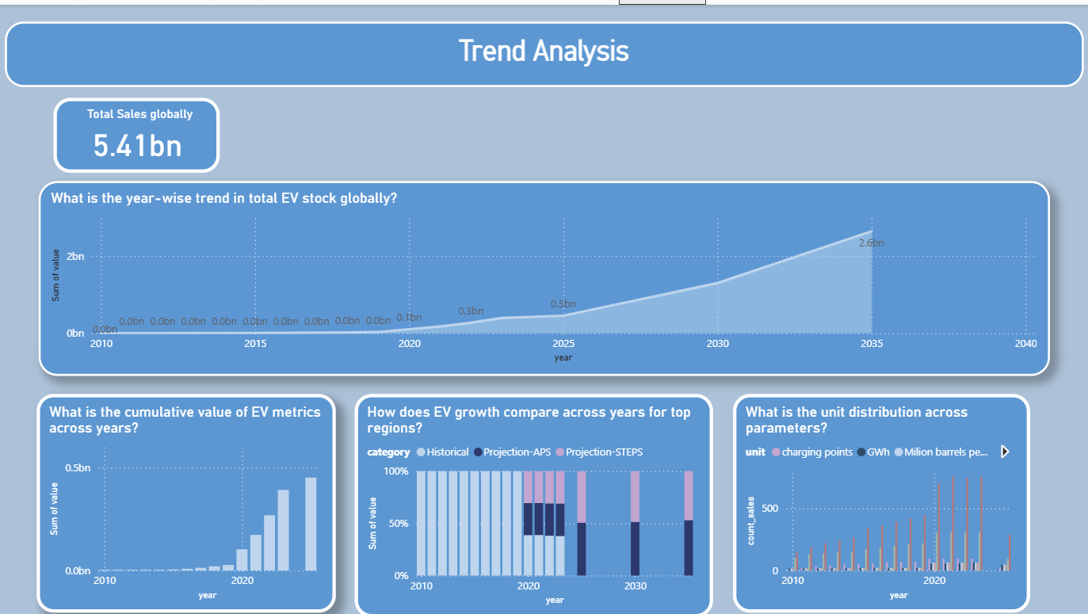

Slide 8
Dashboard Visualizations
Trend Analysis :
Visuals Used:
Line chart , KPI Card
Goal : Visualize the "Hockey Stick" growth curve since 2020.
Key Findings :
Global sales exceeded 17 million in 2024, which is a 25% increase from the previous year.

Slide 9
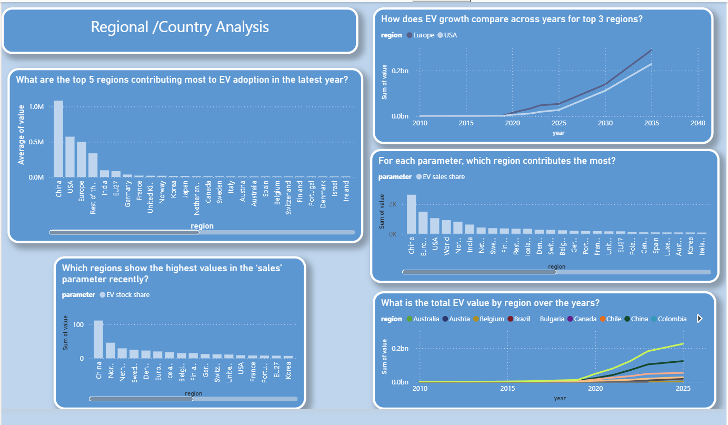

Slide 10
Dashboard Visualizations
Regional Analysis :
Visuals Used: line chart , Clustered Bar Chart
Goal : To Show geographic dominance
Key Findings :
China : Leads the world with over 11 million sales in 2024, Representing nearly 50% of its domestic car market
Europe : Stagnating growth (20 % ) share dure to phasing out of subsidy schemes in major markets
United States : Moderate growth (~ 10% ) reaching in a 1 in 10 sales share

Slide 11
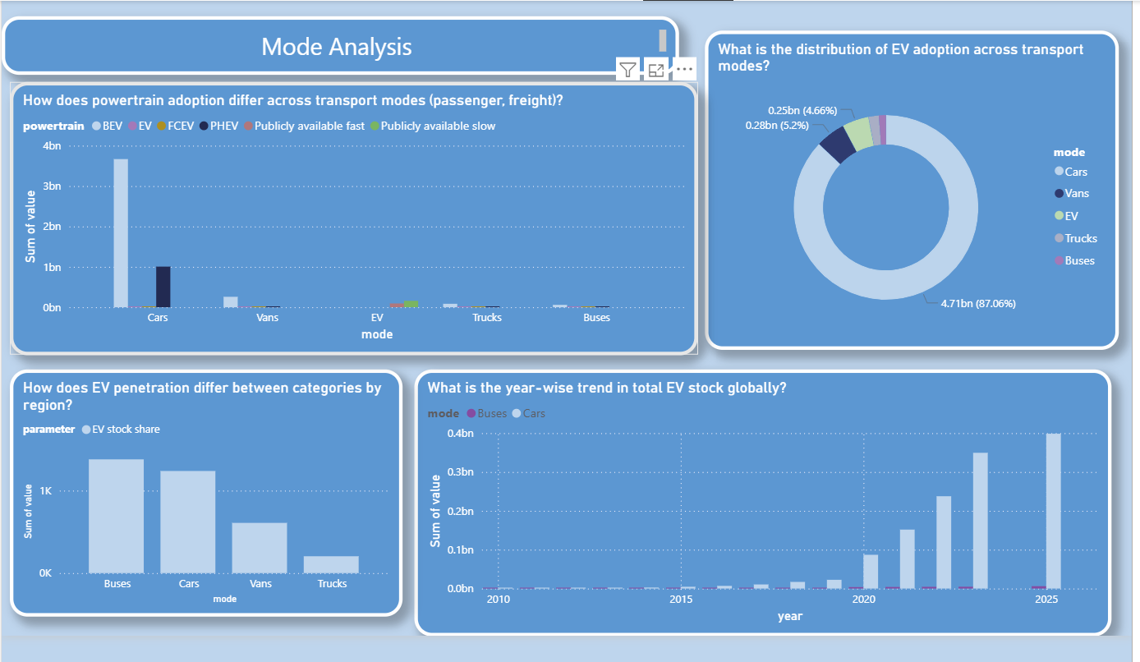

Slide 12
Dashboard Visualizations
Model Analysis :
Visuals Used:
Donut chart , Stacked Column Chart
Goal: Analyze EV adoption across different transport modes, understand distribution patterns, regional penetration, and track global growth trends over time.
Key Findings:
Cars dominate EV adoption with ~87% share
BEVs lead across all transport modes
Buses and cars show higher EV penetration
Post-2020 growth shows rapid EV expansion
Trucks and vans have slower adoption (future potential)

Slide 13
Key Insights
Record Milestone: Global EV sales surpassed 20% market share for
the first time in 2024
Emerging Markets Growth: EV sales doubled in Brazil and grew by ~60%
across Latin America and Southeast Asia
Policy Impact: Changes in regulations or subsidy cuts (e.g., Germany) lead to
immediate drops in EV sales
Policy Support: Enables governments to design targeted incentives to boost
slow-growing markets
Infrastructure Planning: Supports strategic expansion of charging networks
in high-growth regions like Southeast Asia

Slide 14
Challenges
Data Integration Challenges: Combined datasets from multiple global sources (e.g., IEA, regional databases) with differing formats, reporting periods, and vehicle classifications.
Handling Sparse Data: Addressed missing historical data in emerging markets (Latin America, Southeast Asia) without distorting overall growth trends.
Advanced DAX Calculations: Built complex measures for YoY growth and rolling averages to accurately capture seasonal fluctuations.

Slide 15
conclusion
Mainstream Adoption: EVs have reached a global tipping point, with sales consistently
exceeding 20% in key markets
Regional Shift: China leads in volume, while emerging markets show rapid growth despite
slower momentum in parts of Europe
BEV Leadership: BEVs dominate the market, with PHEVs acting as a transitional
solution in certain regions
Key Drivers: Infrastructure development and stable policy support are the primary factors
driving sustained EV growth

Slide 16
Recommendations
Focus on Emerging Markets: Invest in charging infrastructure in high-growth regions
like Brazil, Thailand, and Vietnam
Improve Affordability: Automakers should introduce more cost-effective BEVs to sustain
demand as subsidies decline
Customer Retention: Develop loyalty programs to retain early BEV adopters
and reduce the shift back to ICE or hybrid vehicles

Slide 17

THANK YOU

